Slide 1
C++ Programming: From Problem Analysis to Program Design, Fourth Edition
Chapter 11: Records (structs)

Slide 2
Objectives
In this chapter, you will:
Learn about records (structs)
Examine various operations on a struct
Explore ways to manipulate data using a struct
Learn about the relationship between a struct and functions
Discover how arrays are used in a struct
Learn how to create an array of struct items
‹#›

Slide 3
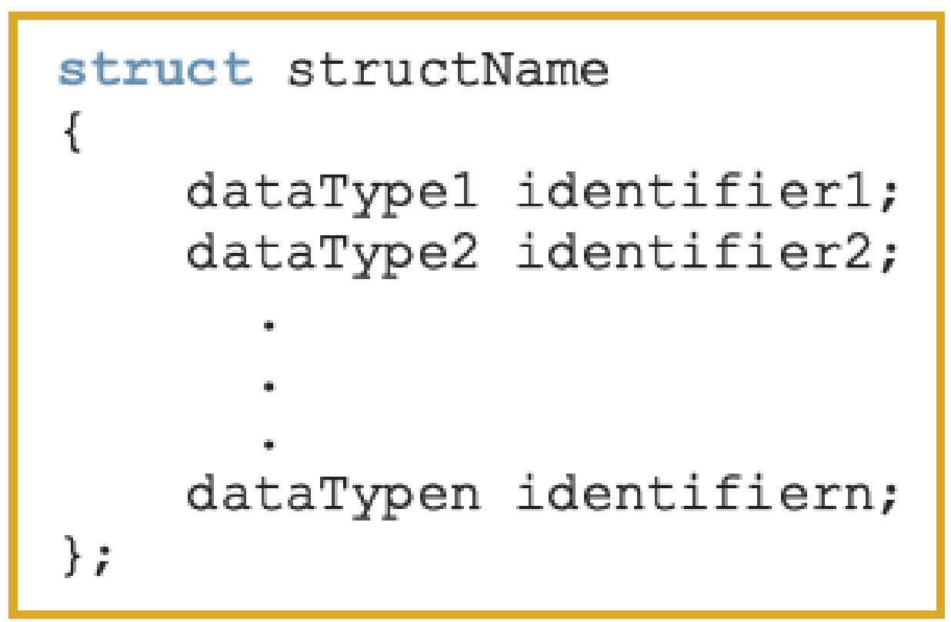
Records (structs)
struct: collection of a fixed number of components (members), accessed by name
A struct is a definition, not a declaration
Members may be of different types
Syntax:
‹#›

Slide 4
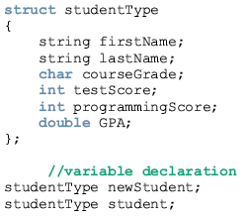
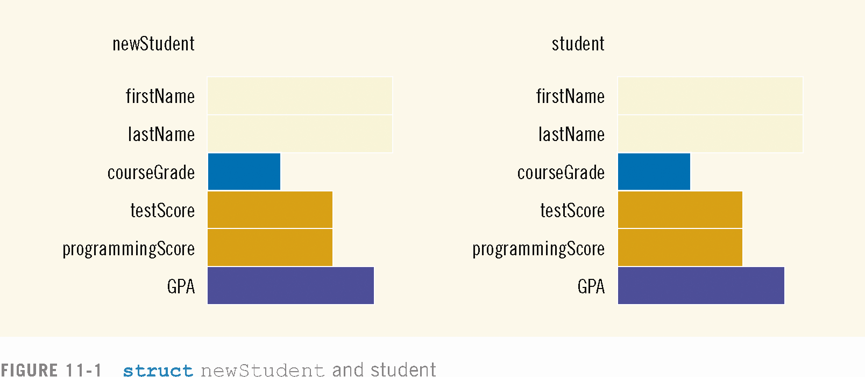

Slide 5

Accessing struct Members
The syntax for accessing a struct member is:
The dot (.) is an operator, called the member access operator
‹#›

Slide 6
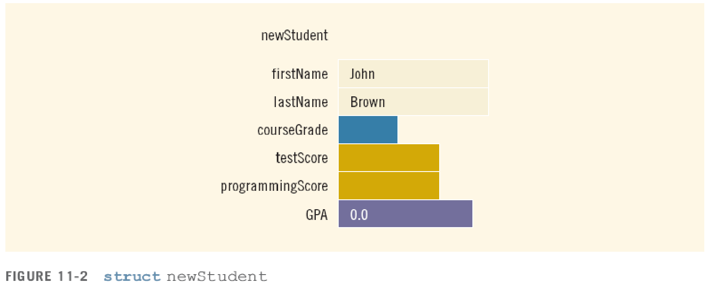
Accessing struct Members (continued)
To initialize the members of newStudent:
newStudent.GPA = 0.0;
newStudent.firstName = "John";
newStudent.lastName = "Brown";
‹#›

Slide 7
Accessing struct Members (continued)
More examples:
cin >> newStudent.firstName;
cin>>newStudent.testScore>>newStudent.programmingScore;
score = (newStudent.testScore + newStudent.programmingScore) / 2;
if (score >= 90)
newStudent.courseGrade = 'A';
else if (score >= 80)
newStudent.courseGrade = 'B';
else if (score >= 70)
newStudent.courseGrade = 'C';
else if (score >= 60)
newStudent.courseGrade = 'D';
else
newStudent.courseGrade = 'F';
‹#›

Slide 8
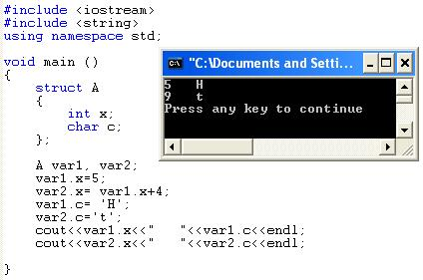
Example:

Slide 9
Assignment
Value of one struct variable can be assigned to another struct variable of the same type using an assignment statement
The statement:
student = newStudent;
copies the contents of newStudent into student
‹#›

Slide 10
Assignment (continued)
The assignment statement:
student = newStudent;
is equivalent to the following statements:
student.firstName = newStudent.firstName;
student.lastName = newStudent.lastName;
student.courseGrade = newStudent.courseGrade;
student.testScore = newStudent.testScore;
student.programmingScore = newStudent.programmingScore;
student.GPA = newStudent.GPA;
‹#›

Slide 11
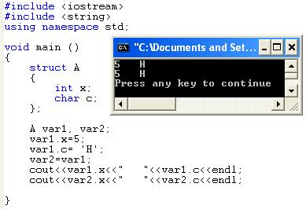
Example:

Slide 12
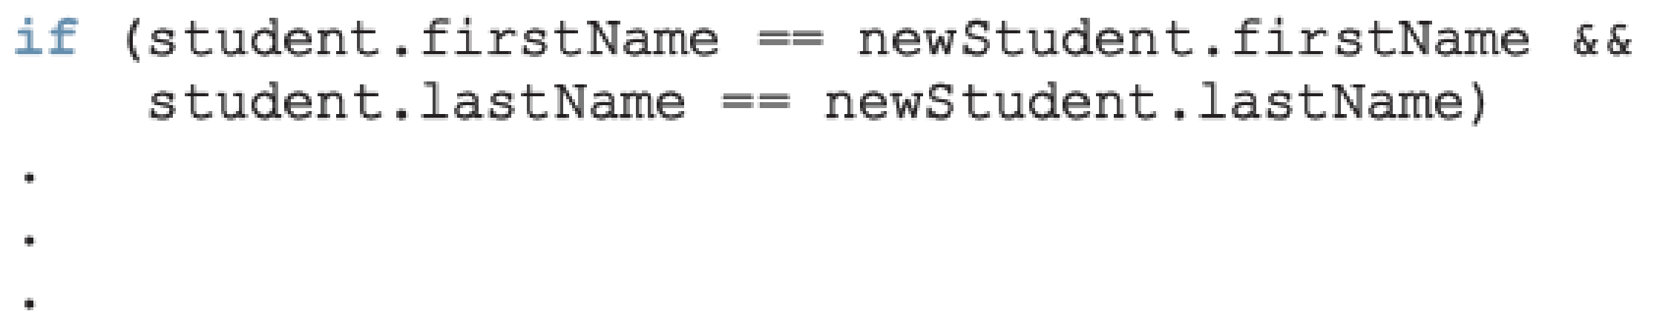
Comparison (Relational Operators)
Compare struct variables member-wise
No aggregate relational operations allowed
To compare the values of student and newStudent:
‹#›

Slide 13
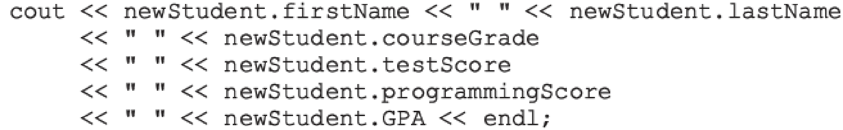
Input/Output
No aggregate input/output operations on a struct variable
Data in a struct variable must be read one member at a time
The contents of a struct variable must be written one member at a time
‹#›

Slide 14
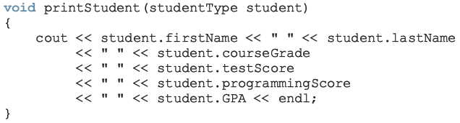
struct Variables and Functions
A struct variable can be passed as a parameter by value or by reference
A function can return a value of type struct
‹#›

Slide 15
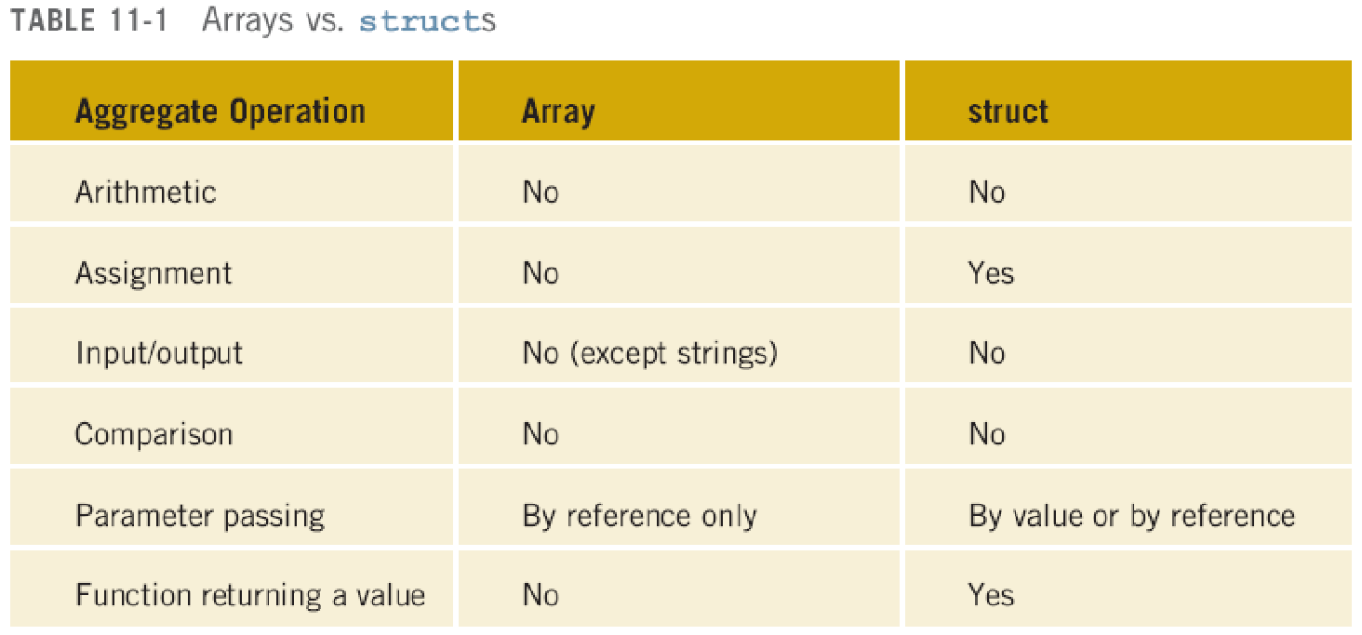
Arrays versus structs
‹#›

Slide 16
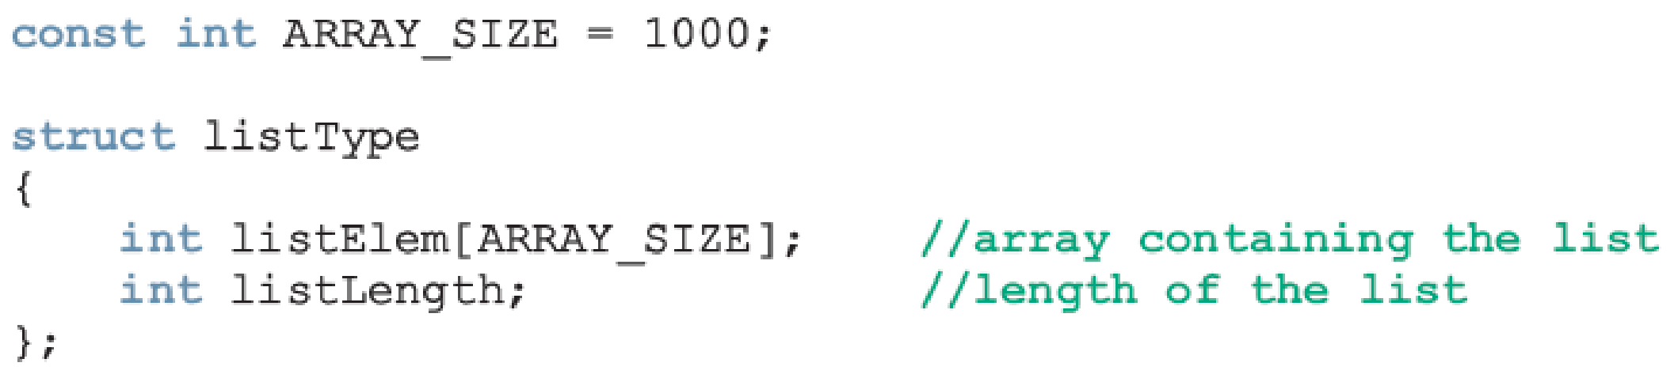
Arrays in structs
Two key items are associated with a list:
Values (elements)
Length of the list
Define a struct containing both items:
‹#›

Slide 17
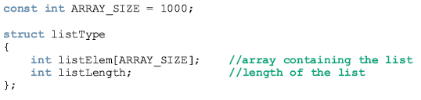
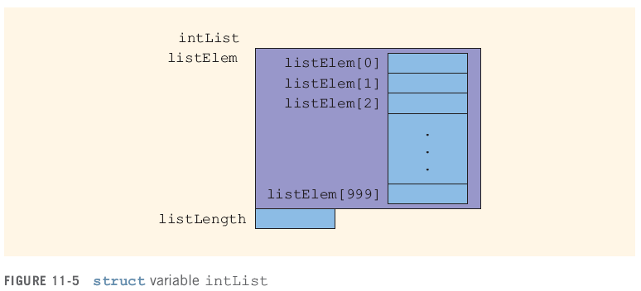

Slide 18

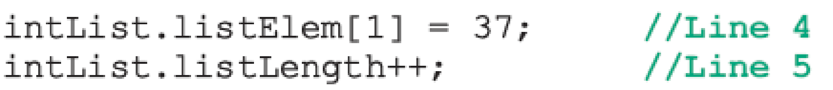
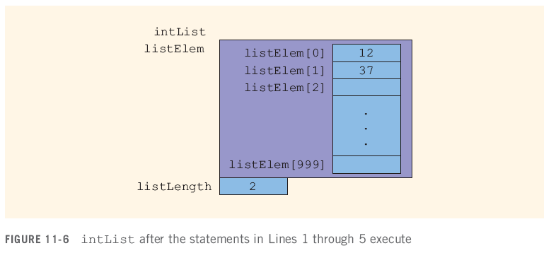
Arrays in structs (cont'd.)
‹#›

Slide 19
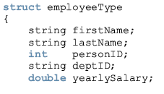

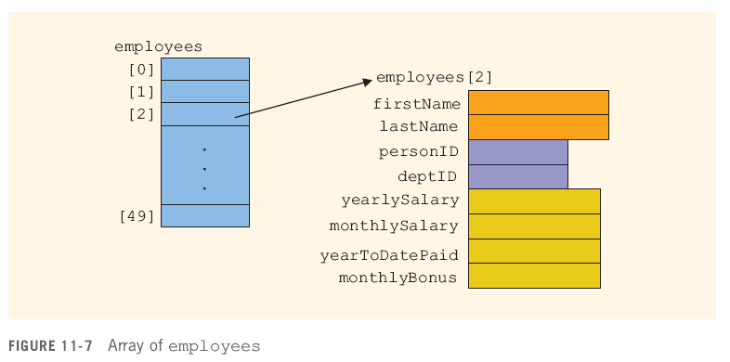

Slide 20
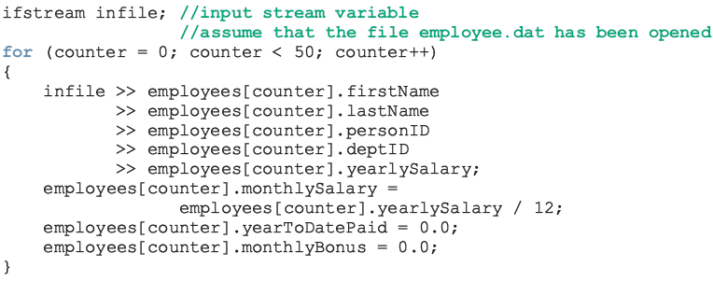
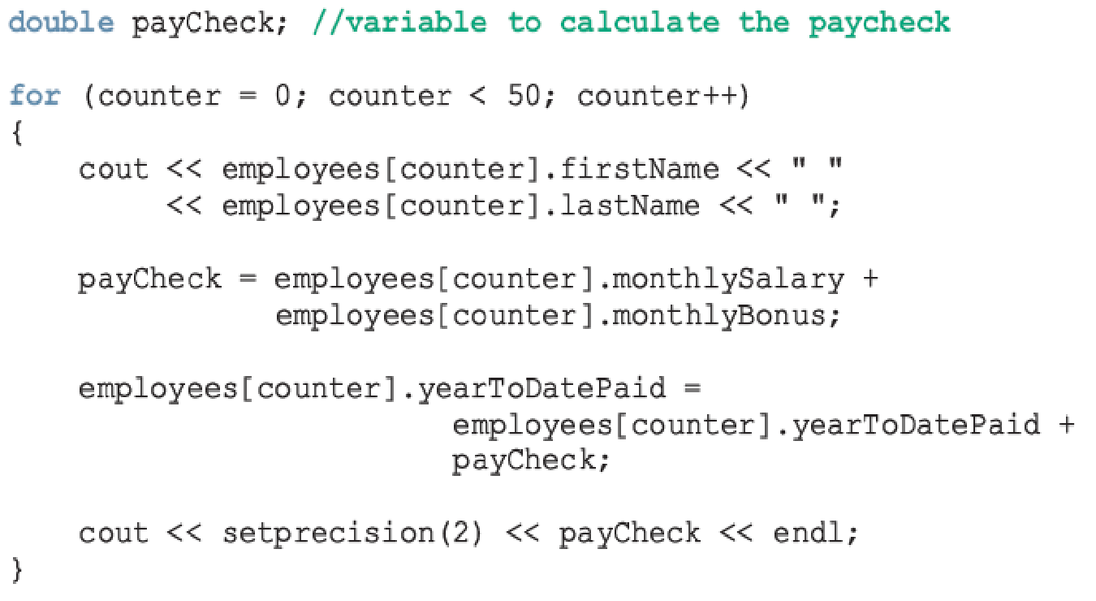

Slide 21
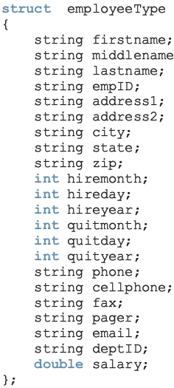
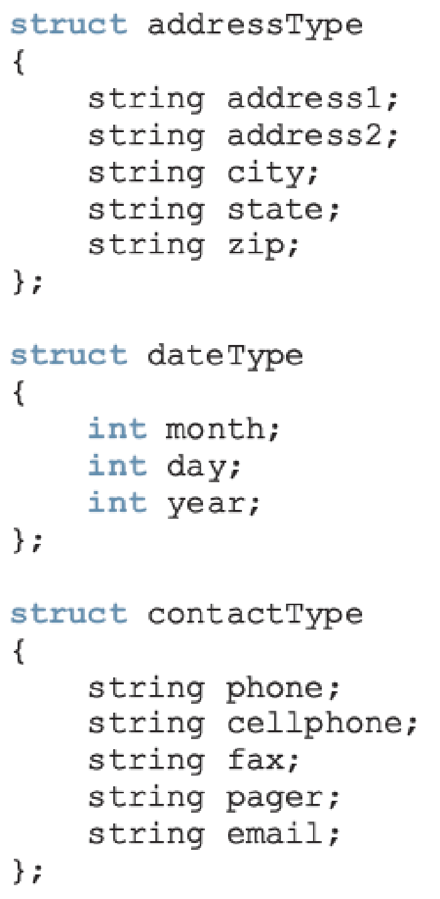
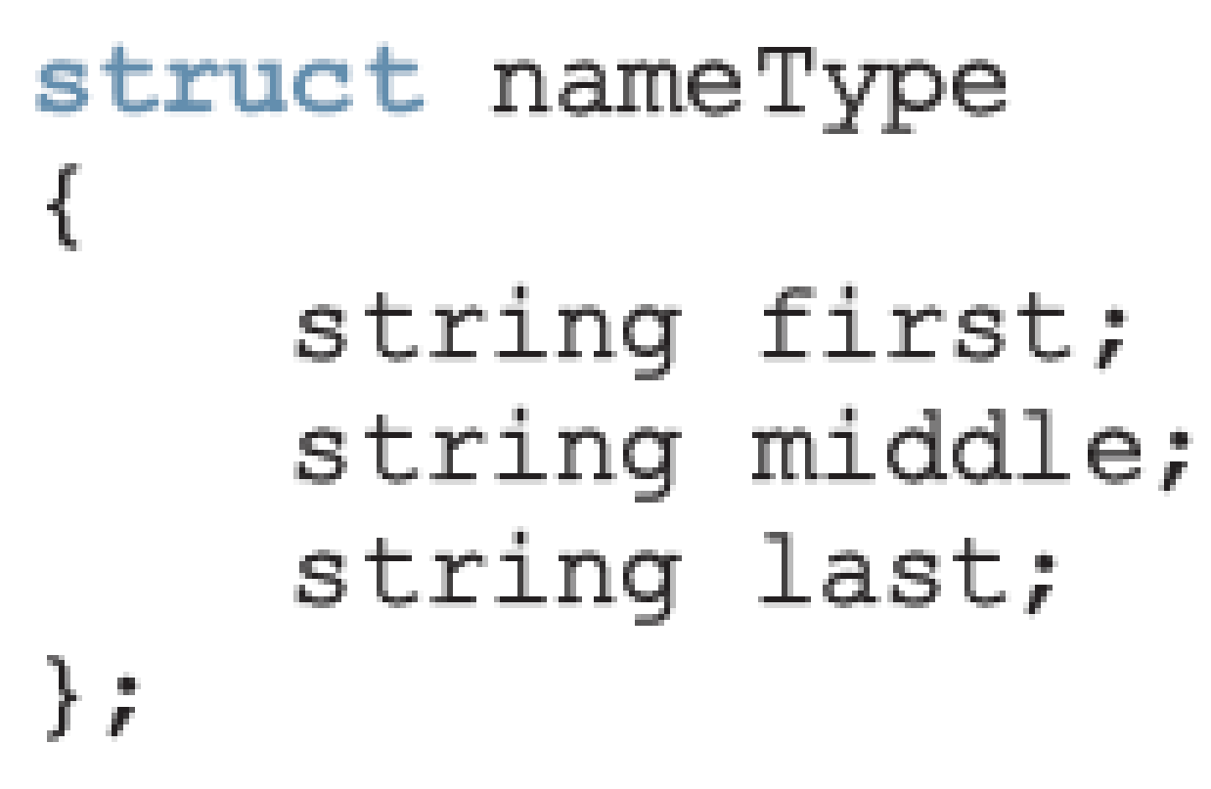
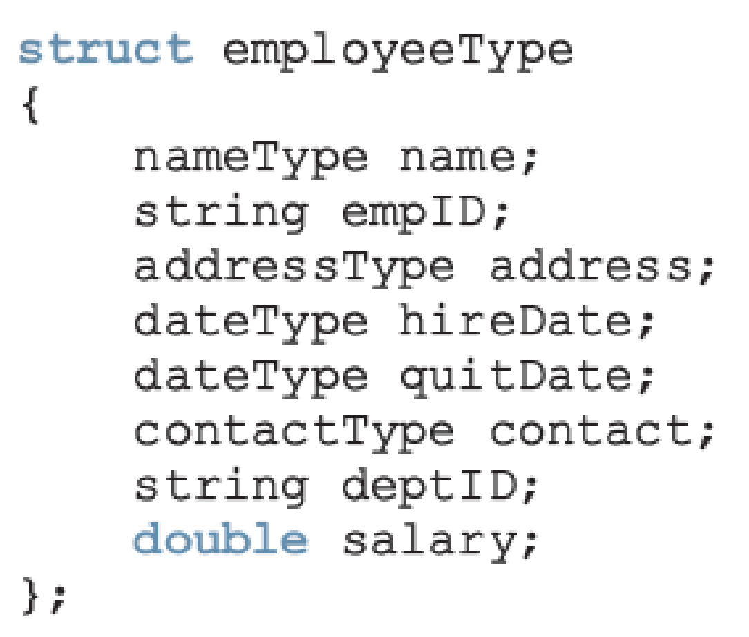
structs within a struct
versus
‹#›

Slide 22
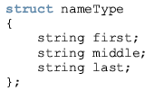
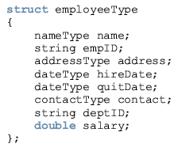
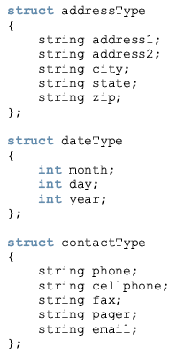

Slide 23

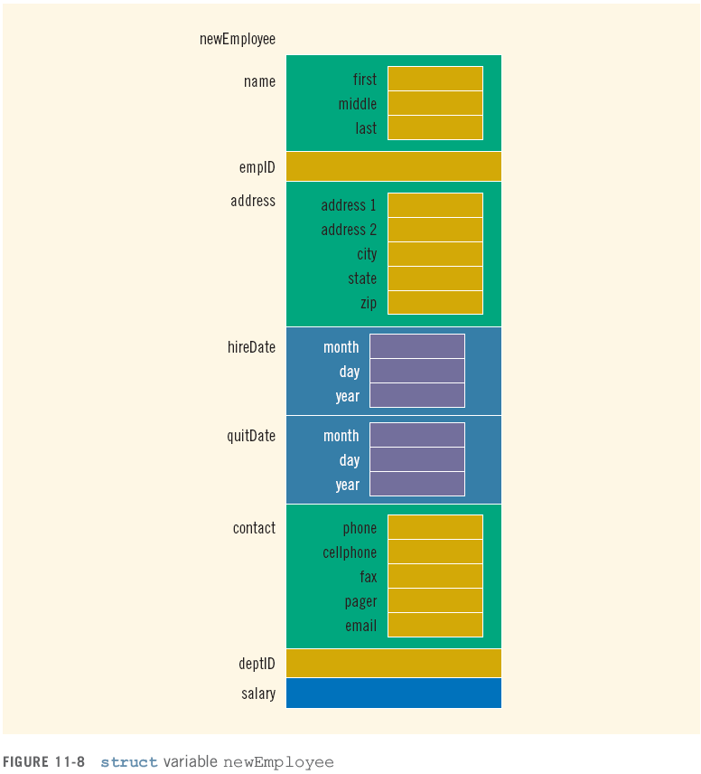

Slide 24
Summary
struct: collection of a fixed number of components
Components can be of different types
Called members
Accessed by name
struct is a reserved word
No memory is allocated for a struct
Memory when variables are declared
‹#›

Slide 25
Summary (continued)
Dot (.) operator: member access operator
Used to access members of a struct
The only built-in operations on a struct are the assignment and member access
Neither arithmetic nor relational operations are allowed on structs
struct can be passed by value or reference
A function can return a value of type struct
structs can be members of other structs
‹#›

